Slide 1
What’s New in Java 9

Slide 2
Resources
http://jdk.java.net/9/
http://openjdk.java.net/projects/jdk9
https://github.com/ESW1234/esw1234.github.io/tree/master/jeff/Ohana/WhatsNewInJava9

Slide 3
Overview
Language and Library Improvements
Collection Factory Methods
ProcessHandle APIs
HttpClient and Support for HTTP/2
G1 Garbage Collector
String Performance
Serialization Filtering
SHA-1 Deprecation
JShell
Modules

Slide 4
Collection Factory Methods
Current way:
List<String> books = new ArrayList<>();
books.add("book 1");
books.add("book 2");
books.add("book 3");
or
List<String> books = Arrays.asList("book 1", "book 2", "book 3");

Slide 5
Collection Factory Methods
Current way:
List<String> books = new ArrayList<>();
books.add("book 1");
books.add("book 2");
books.add("book 3");
or
List<String> books = Arrays.asList("book 1", "book 2", "book 3");
New way:
List<String> books = List.of("book 1", "book 2", "book 3");

Slide 6
Collection Factory Methods
Current way:
List<String> books = new ArrayList<>();
books.add("book 1");
books.add("book 2");
books.add("book 3");
or
List<String> books = Arrays.asList("book 1", "book 2", "book 3");
New way:
List<String> books = List.of("book 1", "book 2", "book 3");
Three new methods:
List.of(…)
Set.of(…)
Map.of(…)

Slide 7
Collection Factory Methods
New methods:
List.of(…)
Set.of(…)
Map.of(…)
List.of()
List.of(E e1)
List.of(E... elements)

Slide 8
Collection Factory Methods
New methods:
List.of(…)
Set.of(…)
Map.of(…)
List.of()
List.of(E e1)
List.of(E... elements) <- intermediate array allocation

Slide 9
Collection Factory Methods
New methods:
List.of(…)
Set.of(…)
Map.of(…)
List.of()
List.of(E e1)
List.of(E... elements) <- intermediate array allocation
List.of(E e1, E e2)
List.of(E e1, E e2, E e3)
List.of(E e1, E e2, E e3, E e4)
List.of(E e1, E e2, E e3, E e4, E e5)
List.of(E e1, E e2, E e3, E e4, E e5, E e6)
List.of(E e1, E e2, E e3, E e4, E e5, E e6, E e7)
List.of(E e1, E e2, E e3, E e4, E e5, E e6, E e7, E e8)
List.of(E e1, E e2, E e3, E e4, E e5, E e6, E e7, E e8, E e9)
List.of(E e1, E e2, E e3, E e4, E e5, E e6, E e7, E e8, E e9, E e10)

Slide 10
Collection Factory Methods
New methods:
List.of(…)
Set.of(…)
Map.of(…)
List.of()
List.of(E e1)
List.of(E... elements) <- intermediate array allocation
List.of(E e1, E e2)
List.of(E e1, E e2, E e3)
List.of(E e1, E e2, E e3, E e4)
List.of(E e1, E e2, E e3, E e4, E e5)
List.of(E e1, E e2, E e3, E e4, E e5, E e6)
List.of(E e1, E e2, E e3, E e4, E e5, E e6, E e7)
List.of(E e1, E e2, E e3, E e4, E e5, E e6, E e7, E e8)
List.of(E e1, E e2, E e3, E e4, E e5, E e6, E e7, E e8, E e9)
List.of(E e1, E e2, E e3, E e4, E e5, E e6, E e7, E e8, E e9, E e10)
Map.of("Key1", 1, "Key2", 2)
Map.ofEntries(Map.entry("Key1", 1), Map.entry("Key2", 2))

Slide 11
ProcessHandle APIs
java.lang.Process
- existing API
- used for only native Java processes

Slide 12
ProcessHandle APIs
java.lang.Process
- existing API
- used for only native Java processes
java.lang.ProcessHandle
- access to any native process in the operating system

Slide 13
ProcessHandle APIs
java.lang.Process
- existing API
- used for only native Java processes
java.lang.ProcessHandle
- access to any native process in the operating system
- any security concerns?

Slide 14
HttpClient and Support for HTTP/2
Current/old API has java.net.HTTPURLConnection, but it's a pain to use

Slide 15
HttpClient and Support for HTTP/2
Current/old API has java.net.HTTPURLConnection, but it's a pain to use
New HttpClient class
- is meant as a replacement for HTTPURLConnection
- is easier to use
- supports HTTP/2
- supports WebSocket
Caveat: the new HttpClient module is inside an incubator module

Slide 16
HttpClient and Support for HTTP/2
Current/old API has java.net.HTTPURLConnection, but it's a pain to use
New HttpClient class
- is meant as a replacement for HTTPURLConnection
- is easier to use
- supports HTTP/2
- supports WebSocket
Caveat: the new HttpClient module is inside an incubator module
HTTP/2 Highlights
Things that are the same in HTTP/1.1:
- Still request/response based
- Popular verbs like GET, PUT, POST, etc... are still there
Things that are different:
- It's a binary protocol
- Transport layer security (TLS) encryption is mandatory (so no http vs. https)
- Can multiplex multiple requests over a single TCP stream
- New server push capabilities - can push resources to the client instead of waiting for a request

Slide 17
G1 Garbage Collector
All GC APIs which were deprecated in Java 8 have been removed in Java 9
G1 (“G-first”) was introduced in JDK 6, and is now the default in JDK 9
The Concurrent Mark Sweep (CMS) collector has been deprecated
can still use it in Java 9, but most likely will be removed in Java 10
a better alternative to the CMS is the G1 Garbage Collector

Slide 18
G1 Garbage Collector
Generational Garbage Collection
The garbage collector acts like this:
we start with a heap containing all the Java objects
the garbage collector divides the heap into three regions:
1. Eden (as in the Garden of Eden). Every object in the heap starts in the Eden region
2. Survivor. Objects that live long enough in Eden, move to the Survivor region.
3. Tenured. If an object lives long enough in the Survivor region,
it eventually moves to the Tenured region.
One problem with this gc algorithm, is that it can lead to very long garbage collection pauses.
With the G1 Garbage Collector, instead of three regions, the heap is segmented up into many Eden, many Survivor, and many Tenured regions, each around 32 MB large.

Slide 19
String Performance
Strings in Java 8 are UTF-16
So “Salesforce” is actually "0S0a0l0e0s0f0o0r0c0e”
When the text is just an ASCII string, this is very wasteful
Compact Strings
In Java 9, the internals of String change from char[] to byte[],
and now has an internal flag (0 - ASCII, 1 - UTF-16)
- the goal is to lower the memory usage
- in JVM 9, you don't have to do a thing. The JVM 9 will try to use
compact strings where ever it can (w/o you changing any code)
If your string is solely ASCII, it takes half the space. It turns out that most strings benefit from this. Some benchmarks show that a typical application can save between 10-15% of their heap.
Performance degradation?

Slide 20
Serialization Filtering
Presently
Java Object -> ObjectOutputStream -> raw bytes
raw bytes -> ObjectInputStream -> Java Object

Slide 21
Serialization Filtering
Presently
Java Object -> ObjectOutputStream -> raw bytes
raw bytes -> ObjectInputStream -> Java Object
This is an attack vector
1) The Java object that's hydrated has the ability to contain executable code
2) An attacker could pass a large chunk of bytes, causing a stack overflow

Slide 22
Serialization Filtering
Presently
Java Object -> ObjectOutputStream -> raw bytes
raw bytes -> ObjectInputStream -> Java Object
This is an attack vector
1) The Java object that's hydrated has the ability to contain executable code
2) An attacker could pass a large chunk of bytes, causing a stack overflow
New system property, jdk.serialFilter, initialized when starting the JVM
maxbytes=n;
maxarray=n;
maxdepth=n; // use these three to limit the size of the
// resulting object, and thus reduce the effects
// of a DoS attack
com.mysite.Remote*; // * indicates that every type that starts with
// Remote can be serialized
com.mysite.dto**; // two ** indicate that subpackages are also allowed
!com.mysite.internal.* // blacklist
NOTE: This serialization filtering has been back ported to Java 6, 7, and 8.

Slide 23
SHA-1 Deprecation
SHA-1 is broken by collision attacks
In Java 9, SHA-1 has been deprecated and support for the SHA-3 family of hash functions has been added

Slide 24
JShell
Not meant to replace IDEs - is just another tool in our toolbox
Main use of JShell is for quickly testing ideas (REPL)
Each line has immediate feedback - no compiling
Don't need to create a "public static void main(String[] args)"
Also don't need semicolons

Slide 25
JShell
Demo

Slide 26
Modules
Before Java 9, the entire Java runtime library was in rt.jar
rt.jar
contains thousands of classes
many classes are entangled with each other
hard to evolve the library due to classes entangled with each other
many internal implementation classes, which were never meant for public consumption, have been used by outside applications (resulting in the public internal implementation classes effectively becoming part of the public API, making it even harder to evolve the language)

Slide 27
Modules
The JDK has been modularized and now consists solely of modules.
Using the module system is optional - you can run your application the way you currently are, or you can choose to use modules.
In both scenarios though you are running on top of the modularized JDK, which can effect your application, even if you chose not to use modules.

Slide 28
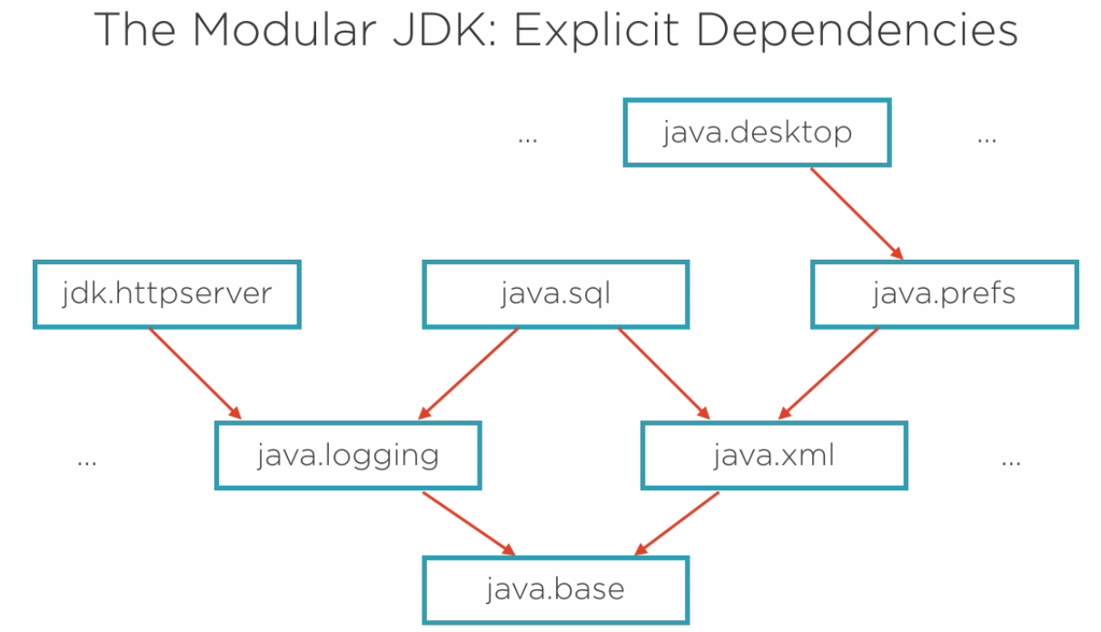
Modules
The JDK has been modularized and now consists solely of modules.

Slide 29
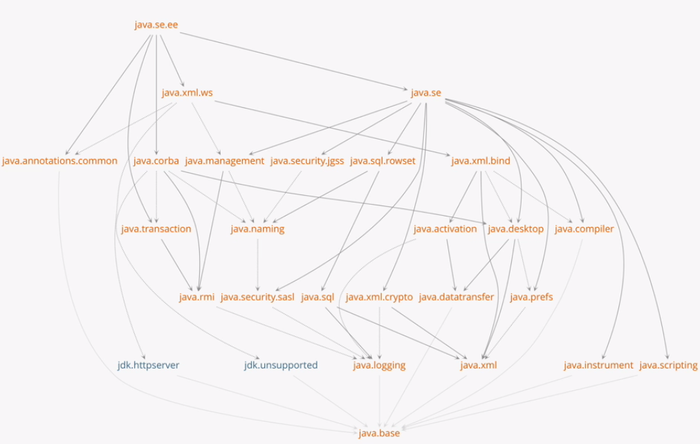
Modules
JDK 9 includes 90+ platform modules

Slide 30
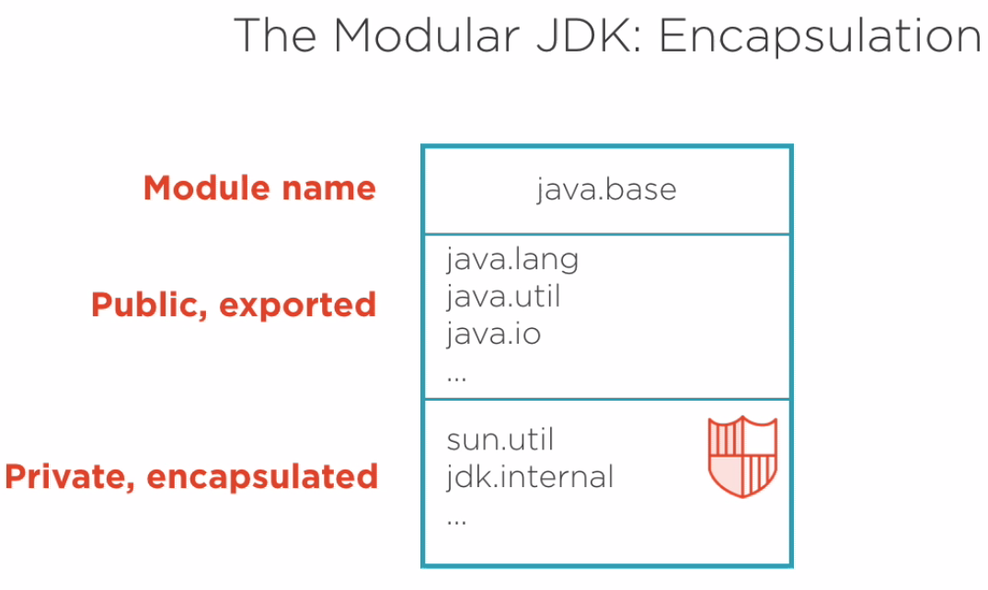
java.base
java.base contains all foundational types of the JDK (string, object, collections, etc...)
Since theses types are so essential, every module has an implicit dependency on java.base, and the implicit dependency is usually never on the dependency diagrams.

Slide 31
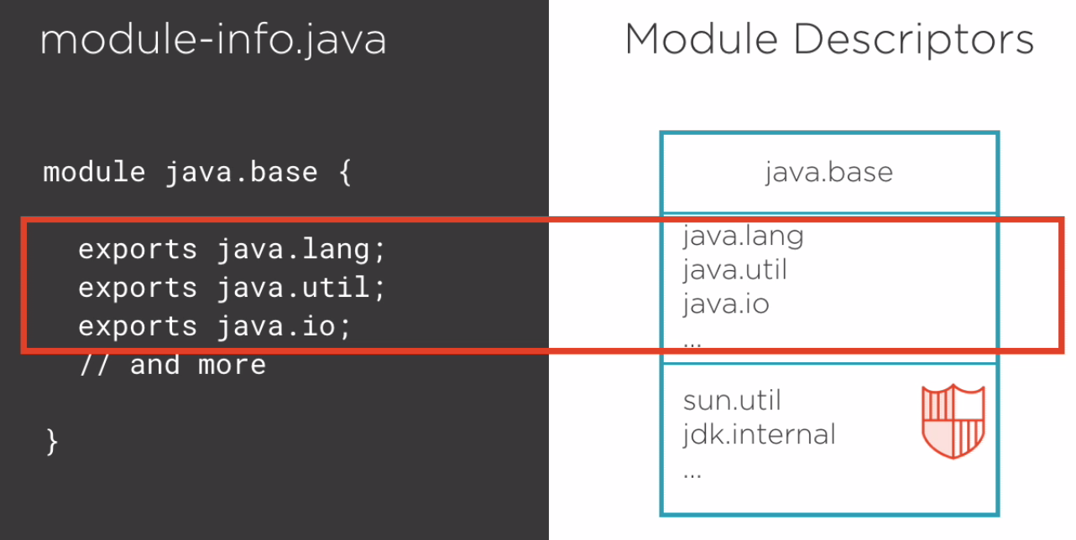
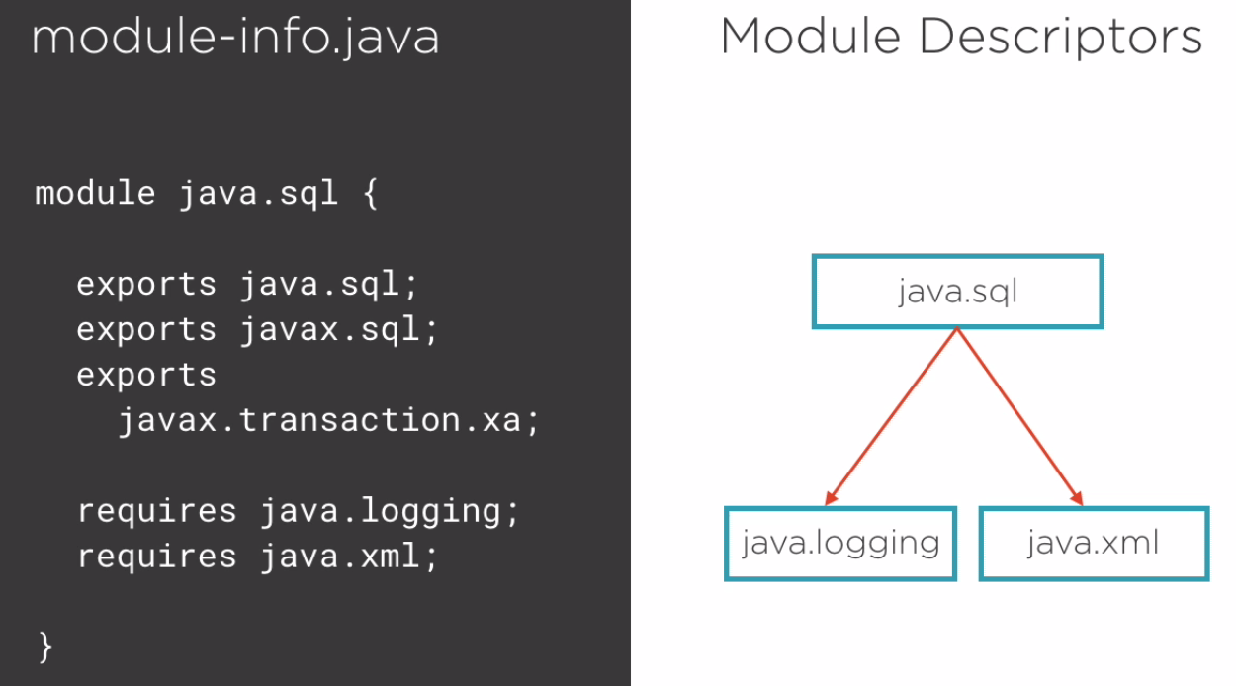
module-info.java

Slide 32
module-info.java
Exports packages
Requires modules

Slide 33
Demo – Test3
runtest=true
runtest=false
not fool-proof: out/production/AnotherModule/com/example/TestX.class

Slide 34
Deprecating Modules
Modularization of the JDK makes it easier to deprecate code.
Example: java.corba is being depreciated. If you use it in Java 9, you will get a warning that it's being deprecated, and will be removed in Java 10.
Upside - it's now easier to add and ship experimental features. All experimental modules have the prefix, jdk.incubator.*, like jdk.incubator.httpclient

Slide 35
“Legacy” code
You can still run non-modularized code in Java 9 (modules are off by default in Java 9).

Slide 36
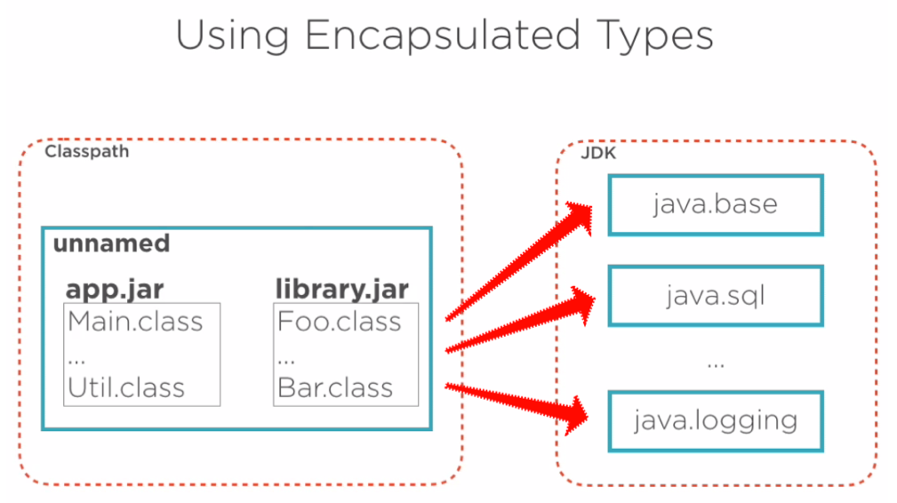
“Legacy” code
You can still run non-modularized code in Java 9 (modules are off by default in Java 9).
When not specifing that the application is using modules (-p and –m), your application’s JARs gets placed in a special/reserved “unnamed” module, which has access to every module in the JDK, and you don’t have to declare the specific modules to use.

Slide 37
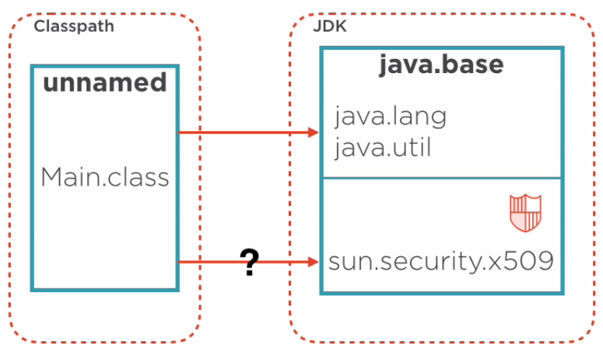
“Legacy” code
This “mostly” works.
Unsupported public classes which are public,
but never meant to be externally consumed,
are now encapsulated and not accessible.

Slide 38
“Legacy” code
This “mostly” works.
Unsupported public classes which are public,
but never meant to be externally consumed,
are now encapsulated and not accessible.
In Java 8, using sun.security.x509.X509Name results in a warning:
warning: X500Name is internal proprietary API and may be removed in a future release
In Java 9, you now get an error:
error: package sun.security.x509 is not visible

Slide 39
“Legacy” code
This “mostly” works.
Unsupported public classes which are public,
but never meant to be externally consumed,
are now encapsulated and not accessible.
In Java 8, using sun.security.x509.X509Name results in a warning:
warning: X500Name is internal proprietary API and may be removed in a future release
In Java 9, you now get an error:
error: package sun.security.x509 is not visible
Workaround:
java --add-exports java.base/sun.security.x509=ALL-UNNAMED Main

Slide 40
Tools
jdeps
java --list-modules

